Slide 1

3ʳᵈ REVIEW MULTI-MODAL AI FOR CANCER CELL BEHAVIOUR AND DRUG DISCOVERY
DEPARTMENT OF COMPUTER SCIENCE AND ENGINEERING
PROJECT SUPERVISOR:
Dr. E.SYED MOHAMED
PROFESSOR
NAME OF THE STUDENTS:
AAFIYAH TASNEEM H (220071601001)
FAATHIMA NAWFA B (220071601059)
TEAM 01
MULTI-MODAL AI FOR CANCER CELL BEHAVIOUR AND DRUG DISCOVERY
01

Slide 2
DESCRIPTION
• Cancer treatment requires identifying drugs that effectively target tumour behavior and biological characteristics.
• Tumour behavior varies due to differences in cellular structure and biological activity, making drug selection complex.
• Traditional drug discovery relies on laboratory experiments and clinical trials, which are time-consuming and expensive.
• Advances in Artificial Intelligence and computational pathology enable automated analysis of histopathology images to extract meaningful tumour features.
• Integrating tumour phenotype information with molecular drug intelligence can help identify potential therapeutic candidates.
MULTI-MODAL AI FOR CANCER CELL BEHAVIOUR AND DRUG DISCOVERY
02

Slide 3
PROBLEM STATEMENT
Most existing cancer diagnosis systems focus mainly on tumour detection and classification, rather than recommending suitable treatments.
Histopathology images contain important biological information about tumour behavior, but this information is rarely used in drug discovery
Many drug prediction systems do not incorporate tumour morphology or tissue characteristics, limiting their effectiveness.
There is limited integration between tumour analysis and pharmacological knowledge.
This creates a gap between tumour diagnosis and personalized drug recommendation.
MULTI-MODAL AI FOR CANCER CELL BEHAVIOUR AND DRUG DISCOVERY
03

Slide 4
OBJECTIVES
Extract tumour phenotype information from histopathology images to understand tumour morphology and behavior.
Model cellular spatial interactions using graph representations to capture tumour micro-architecture.
Learn molecular drug representations using Graph Neural Networks (GNN) from molecular structures.
Integrate tumour phenotype with pharmacological knowledge for biologically meaningful analysis.
Generate subtype-guided drug recommendations based on tumour phenotype and drug sensitivity patterns.
MULTI-MODAL AI FOR CANCER CELL BEHAVIOUR AND DRUG DISCOVERY
04

Slide 5
EXISTING SYSTEM
• Most existing cancer analysis systems focus mainly on tumour detection and classification using histopathology images.
• Traditional drug discovery methods rely heavily on laboratory experiments and clinical trials, making the process time-consuming and expensive.
• Many AI-based medical systems analyze tumour images only for diagnosis, without linking tumour characteristics to treatment strategies.
• Drug prediction approaches often depend on molecular data alone, without considering tumour morphology or tissue structure.
• Limited integration exists between tumour image analysis and pharmacological drug response data.
MULTI-MODAL AI FOR CANCER CELL BEHAVIOUR AND DRUG DISCOVERY
05

Slide 6
PROPOSED SYSTEM
The proposed system introduces a Subtype-Guided Drug Recommendation Framework that integrates tumour phenotype modeling with molecular drug intelligence.
Histopathology images are analyzed to extract tumour morphological features and cellular characteristics using computational pathology techniques.
Cellular spatial interactions are modeled as graphs, and Graph Neural Networks are used to learn tumour behavior patterns.
Drug molecules are represented as molecular graphs and encoded using a molecular GNN to learn meaningful drug embeddings.
Tumour phenotype information is combined with pharmacogenomic drug sensitivity data to generate subtype-guided drug recommendations.
MULTI-MODAL AI FOR CANCER CELL BEHAVIOUR AND DRUG DISCOVERY
06

Slide 7
Project Plan Breakdown
Phase 1:Data Collection & Environment Setup
Identify and collect relevant datasets for tumour analysis and drug modeling:
scenarios:
Phase 2: Phase 2: Image Preprocessing & Nuclei Detection
Prepare histopathology images to highlight cellular structures for analysis.
Scenarios:
Convert images to grayscale and apply noise reduction
Perform threshold segmentation to isolate nuclei
Apply morphological operations for image cleaning
Detect cell contours and structural patterns
Prepare processed images for feature extraction
Collect histopathology images from the BreaKHis dataset
Obtain molecular drug bioactivity data from the ChEMBL database
Acquire drug sensitivity data from the GDSC dataset
Configure development environment and AI/ML libraries
Prepare datasets for model training
MULTI-MODAL AI FOR CANCER CELL BEHAVIOUR AND DRUG DISCOVERY
07

Slide 8
Project Plan Breakdown
Phase 4: Cellular Graph Construction & GNN Learning
Model spatial relationships between cells using graph structures:
Scenarios:
Represent detected cells as nodes in a graph
Construct edges based on spatial proximity
Train a Graph Neural Network (GNN) to learn cell interactions
Extract graph embeddings representing tumour structure
Capture spatial cellular behaviour patterns
Phase 3: CNN Feature Extraction
Extract deep visual features from histopathology images.
Scenarios:
Implement a CNN model for tissue feature extraction
Train the network on histopathology images
Extract high-level texture and morphology features
Generate feature embeddings for tumour analysis
Store extracted features for multimodal fusion
MULTI-MODAL AI FOR CANCER CELL BEHAVIOUR AND DRUG DISCOVERY
08

Slide 9
Project Plan Breakdown
Phase 5: Multimodal Feature Fusion
Combine image and graph features to capture tumour behaviour.
Scenarios:
Merge CNN image features with GNN embeddings
Apply feature scaling and normalization
Generate a fused feature representation
Use fused features for tumour phenotype analysis
Prepare data for tumour subtype prediction
Phase 6: Tumour Phenotype Prediction
Predict tumour behaviour based on fused features.
Scenarios:
Apply clustering techniques to classify tumour patterns
Categorize tumour behaviour into phenotype groups
Identify patterns such as indolent, moderate, or aggressive
Analyze tumour morphological characteristics
Generate predicted tumour phenotype
MULTI-MODAL AI FOR CANCER CELL BEHAVIOUR AND DRUG DISCOVERY
09

Slide 10
Project Plan Breakdown
Phase 7: Explainable AI Integration
Provide visual explanations for model predictions.
Scenarios:
Implement Grad-CAM for image-based explanations
Apply SHAP to analyze feature importance
Highlight tissue regions influencing predictions
Interpret contributions of CNN and GNN features
Improve transparency of the AI model
Generate a list of candidate therapeutic drugs
Rank drugs based on predicted effectiveness
Visualize drug effectiveness results
Phase 9: Web Application & System Integration
Deploy the system through an interactive interface. Scenarios:
Phase 8: Drug Recommendation
ModuleRecommend candidate drugs based on tumour phenotype.
Scenarios:
Map tumour phenotype to drug response datasets
Use IC50 values and compatibility scores for ranking
Develop a Streamlit-based web application
Implement histopathology image upload functionality
Display preprocessing steps and model predictions
Show explainable AI visualizations and drug rankings
Integrate all modules into a complete system
MULTI-MODAL AI FOR CANCER CELL BEHAVIOUR AND DRUG DISCOVERY
10

Slide 11
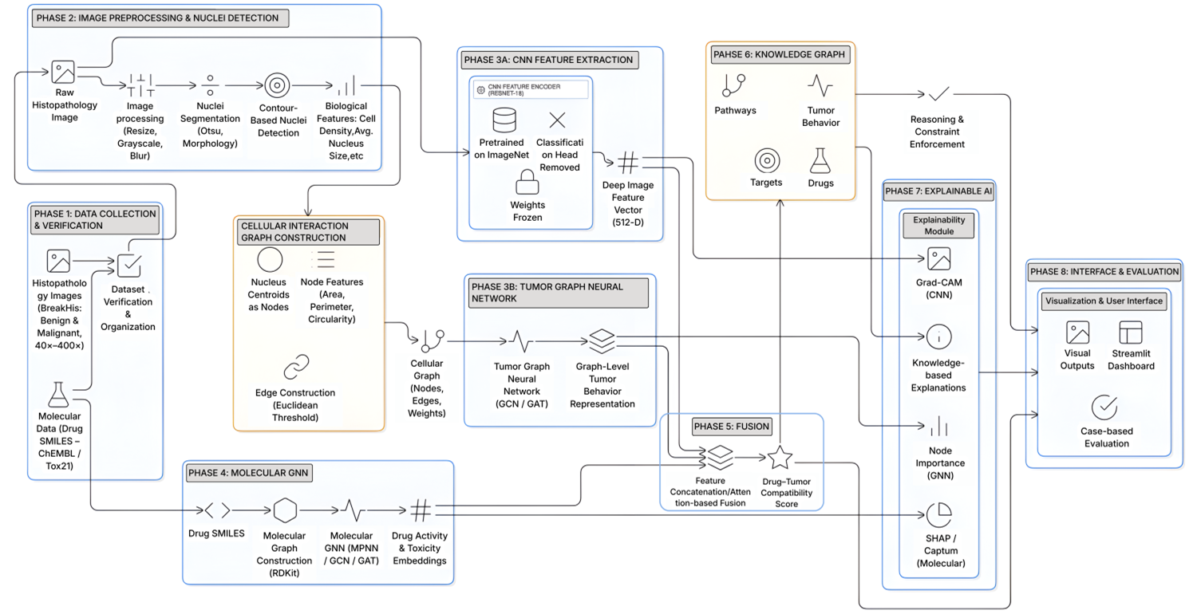
ARCHITECTURE DIAGRAM
MULTI-MODAL AI FOR CANCER CELL BEHAVIOUR AND DRUG DISCOVERY
11

Slide 12
MODULES
Module I: Image Processing Module
Processes histopathology images to prepare them for analysis. It performs image resizing, grayscale conversion, noise reduction, and segmentation to identify cellular structures within tumour tissue.
Module II: Nuclei Detection & Feature Extraction Module
Detects individual cell nuclei from histopathology images using contour detection and morphological operations. Extracts quantitative cellular features such as nuclear area, perimeter, and cell density.
Module III: Cellular Graph Construction Module
Constructs cellular interaction graphs where each nucleus represents a node. Edges are created based on spatial proximity between nuclei to capture tumour micro-architecture.
MULTI-MODAL AI FOR CANCER CELL BEHAVIOUR AND DRUG DISCOVERY
12

Slide 13
MODULES
Module IV: Tumour Representation Learning Module Uses deep learning models to learn tumour characteristics. CNN models extract morphological features from images, while Graph Neural Networks analyze cellular graphs to capture spatial interactions.
Module V: Molecular Intelligence Module Processes molecular drug data from the ChEMBL database. Drug molecules are converted into molecular graphs and encoded using a molecular Graph Neural Network to learn drug embeddings.
Module VI: Tumour Phenotype Modeling Module Combines CNN features, cellular graph embeddings, and nuclei metrics to generate tumour phenotype vectors that represent tumour behavior patterns.
MULTI-MODAL AI FOR CANCER CELL BEHAVIOUR AND DRUG DISCOVERY
13

Slide 14
MODULES
Module VII: Subtype Inference Module Uses clustering techniques to group tumours into phenotype-based subtype categories such as indolent-like, moderate-like, or aggressive-like.
Module VIII: Drug Recommendation Module Maps tumour subtype information to drug sensitivity patterns derived from the GDSC dataset and generates a ranked list of potential therapeutic drugs.
MULTI-MODAL AI FOR CANCER CELL BEHAVIOUR AND DRUG DISCOVERY
14

Slide 15
LITERATURE SURVEY
Title | Year | Author | Problem addressed | Implementation | Limitation | Advantage
TARSL: Triple-Attention Cross-Network Representation Learning | 2025 | Jinxin Li et al. | Identifying synthetic lethal gene pairs | Triple-attention deep learning on biological networks | High computational cost | Better gene interaction prediction
Histopathology Image Analysis for Cancer Classification | 2022 | Spanhol et al. | Manual tumour subtype detection | CNN-based tissue classification | Limited interpretability | Accurate tumour detection
Graph Neural Networks for Drug-Target Interaction | 2021 | Zitnik et al. | Predicting drug-target relationships | GNN using molecular graphs | Requires large datasets | Captures structural drug relations
Multimodal Deep Learning for Cancer Drug Discovery | 2023 | Huang et al. | Integrating heterogeneous biomedical data | Multimodal feature fusion model | Complex training process | Improved prediction performance
Explainable AI for Medical Image Analysis | 2022 | Selvaraju et al. | Lack of transparency in deep models | Grad-CAM visualization | Coarse explanation detail | Improves model interpretability
MULTI-MODAL AI FOR CANCER CELL BEHAVIOUR AND DRUG DISCOVERY
15

Slide 16
LITERATURE SURVEY
Title | Year | Author | Problem addressed | Implementation | Limitation | Advantage
Deep Learning for Histopathology Cancer Diagnosis | 2023 | Bera et al. | Manual tumour grading from pathology slides | CNN-based histopathology analysis | Requires annotated datasets | Automated cancer detection
Graph Neural Networks for Drug Response Prediction | 2024 | Wang et al. | Predicting drug effectiveness on cancer cells | GNN using molecular and cell graphs | High computational complexity | Captures drug–cell interactions
Multimodal Learning for Precision Oncology | 2024 | Chen et al. | Integrating clinical, genomic, and imaging data | Multimodal deep learning fusion | Data heterogeneity challenges | Improves personalized treatment prediction
Explainable AI for Medical Imaging | 2023 | Tjoa et al. | Lack of transparency in medical AI models | Explainable deep learning methods | Limited interpretability depth | Enhances trust in AI diagnosis
Deep Learning for Drug Discovery in Cancer | 2025 | Zhang et al. | Identifying effective anti-cancer drugs | Deep neural networks on biomedical datasets | Large training data required | Accelerates drug discovery process
MULTI-MODAL AI FOR CANCER CELL BEHAVIOUR AND DRUG DISCOVERY
16

Slide 17
ALGORITHM DESCRIPTION
Algorithm 1: Data Initialization
Load required datasets including BreaKHis images, ChEMBL molecular data, and GDSC drug sensitivity records.
Algorithm 2: Image Preprocessing
Perform resizing, grayscale conversion, smoothing, and thresholding to enhance histopathology images.
Algorithm 3: Nuclei Detection
Detect cell nuclei using contour detection and extract features such as nuclear area and cell density
Algorithm 4: Cellular Graph Construction
Construct a cellular interaction graph where detected nuclei represent nodes and edges represent spatial proximity relationships between cells.
Algorithm 5: CNN-Based Tumour Feature Extraction
Apply a Convolutional Neural Network (CNN) to histopathology images to extract high-level texture and morphology features representing tumour tissue patterns.
MULTI-MODAL AI FOR CANCER CELL BEHAVIOUR AND DRUG DISCOVERY
17

Slide 18
ALGORITHM DESCRIPTION
Algorithm 6: Graph Neural Network (GNN) Learning
Apply a Graph Neural Network (GNN) on the cellular graph to learn spatial interactions between tumour cells and generate graph embeddings.
Algorithm 7: Multimodal Feature Fusion
Combine CNN image features and GNN graph embeddings to create a unified feature representation describing tumour behaviour.
Algorithm 8: Tumour Phenotype Prediction
Use clustering techniques to classify tumour behaviour into phenotype groups such as indolent-like, moderate-like, or aggressive-like.
Algorithm 9: Drug Recommendation
Map predicted tumour phenotypes to GDSC drug response data and generate a ranked list of candidate drugs using compatibility scores and IC50 values.
MULTI-MODAL AI FOR CANCER CELL BEHAVIOUR AND DRUG DISCOVERY
18

Slide 19
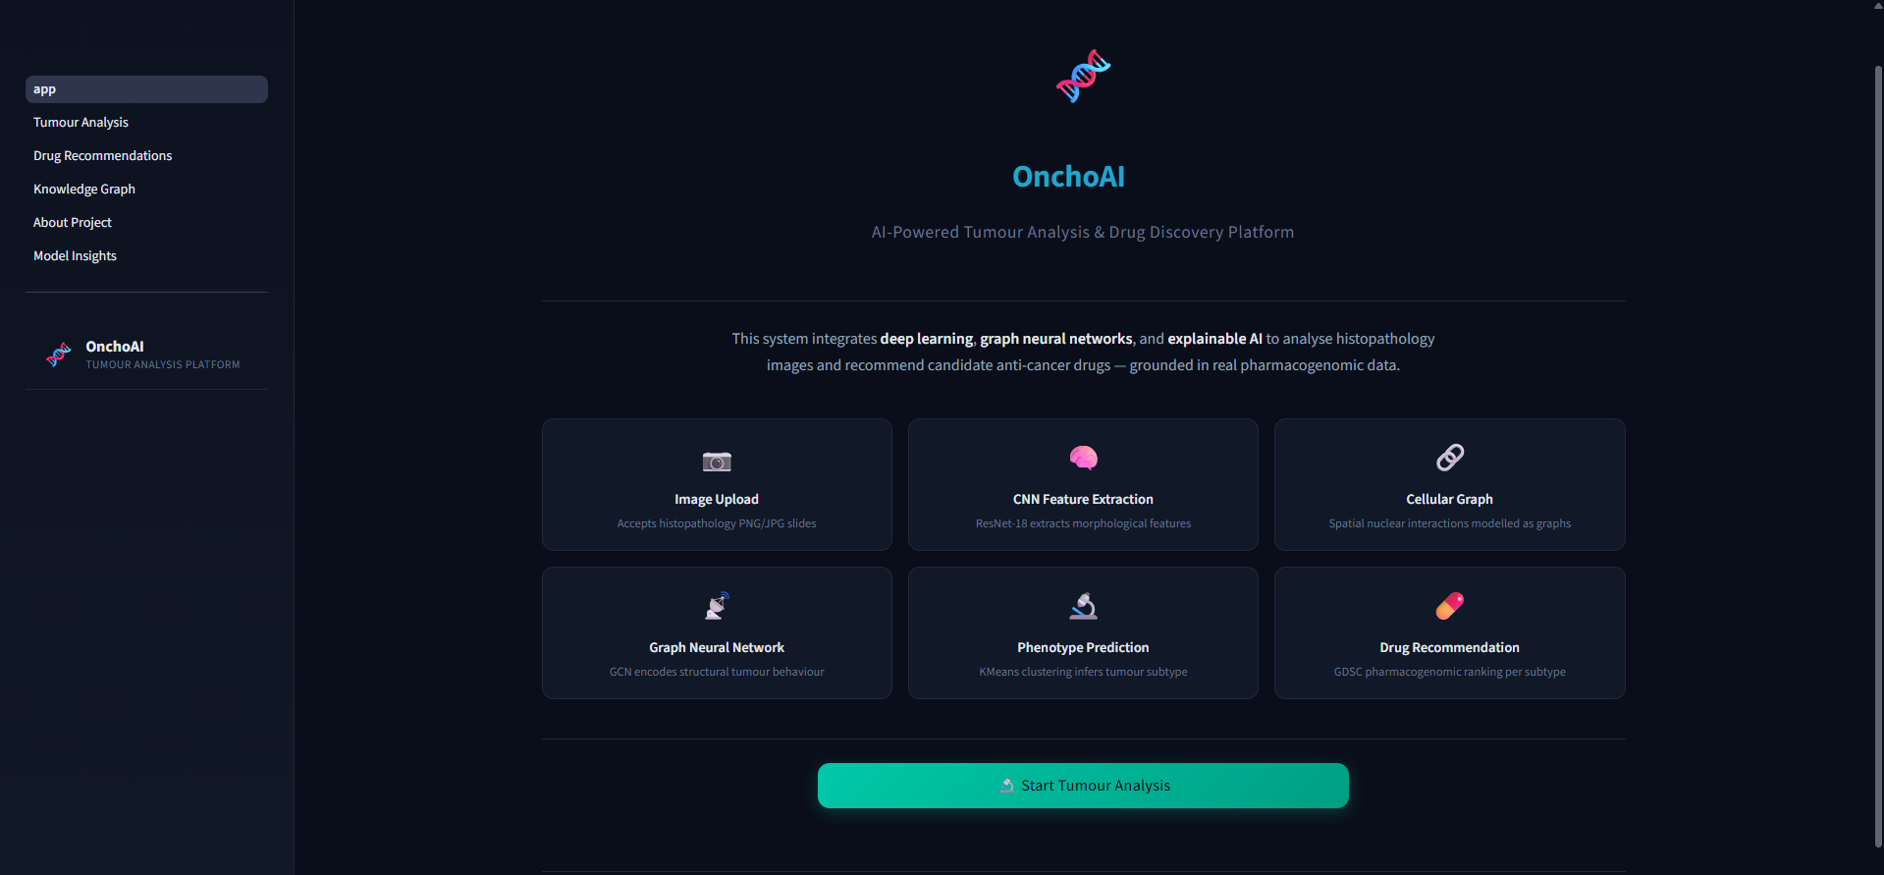
DEMO OUTPUT
MULTI-MODAL AI FOR CANCER CELL BEHAVIOUR AND DRUG DISCOVERY
19

Slide 20
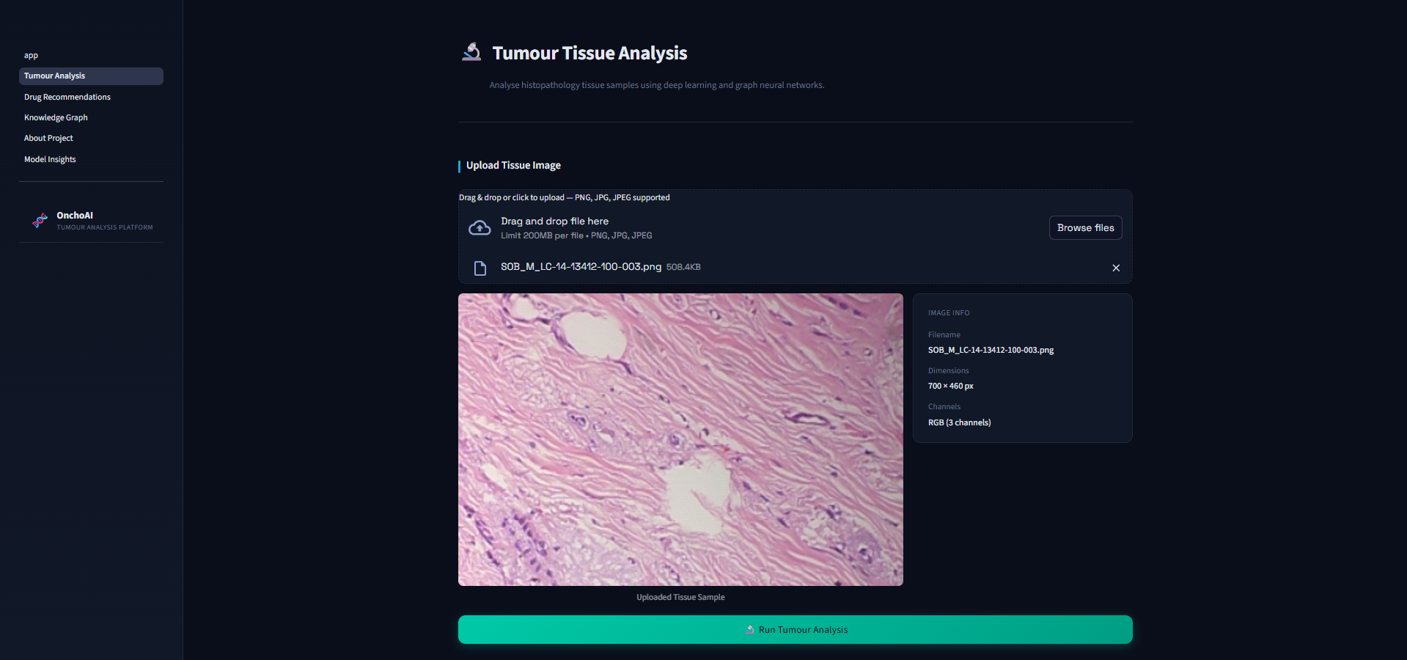
DEMO OUTPUT
MULTI-MODAL AI FOR CANCER CELL BEHAVIOUR AND DRUG DISCOVERY
20

Slide 21
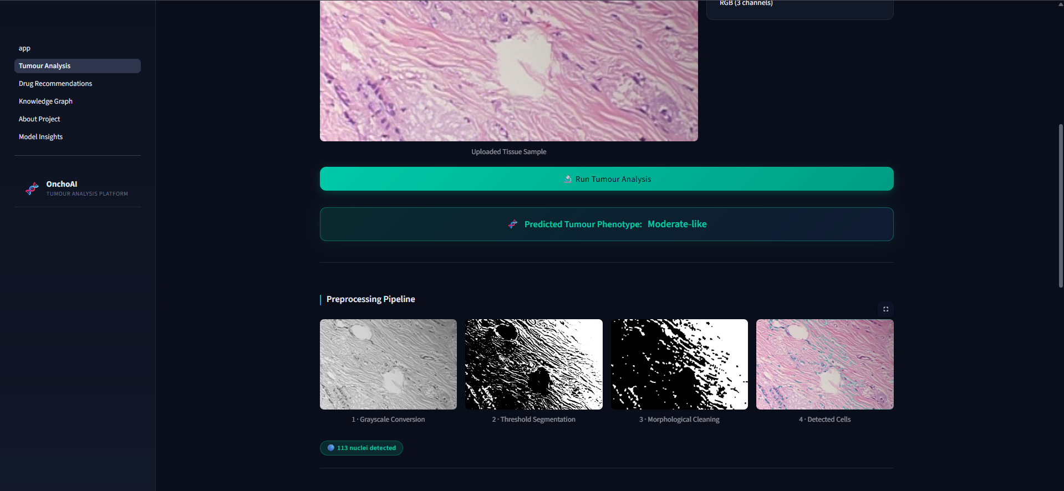
DEMO OUTPUT
MULTI-MODAL AI FOR CANCER CELL BEHAVIOUR AND DRUG DISCOVERY
21

Slide 22
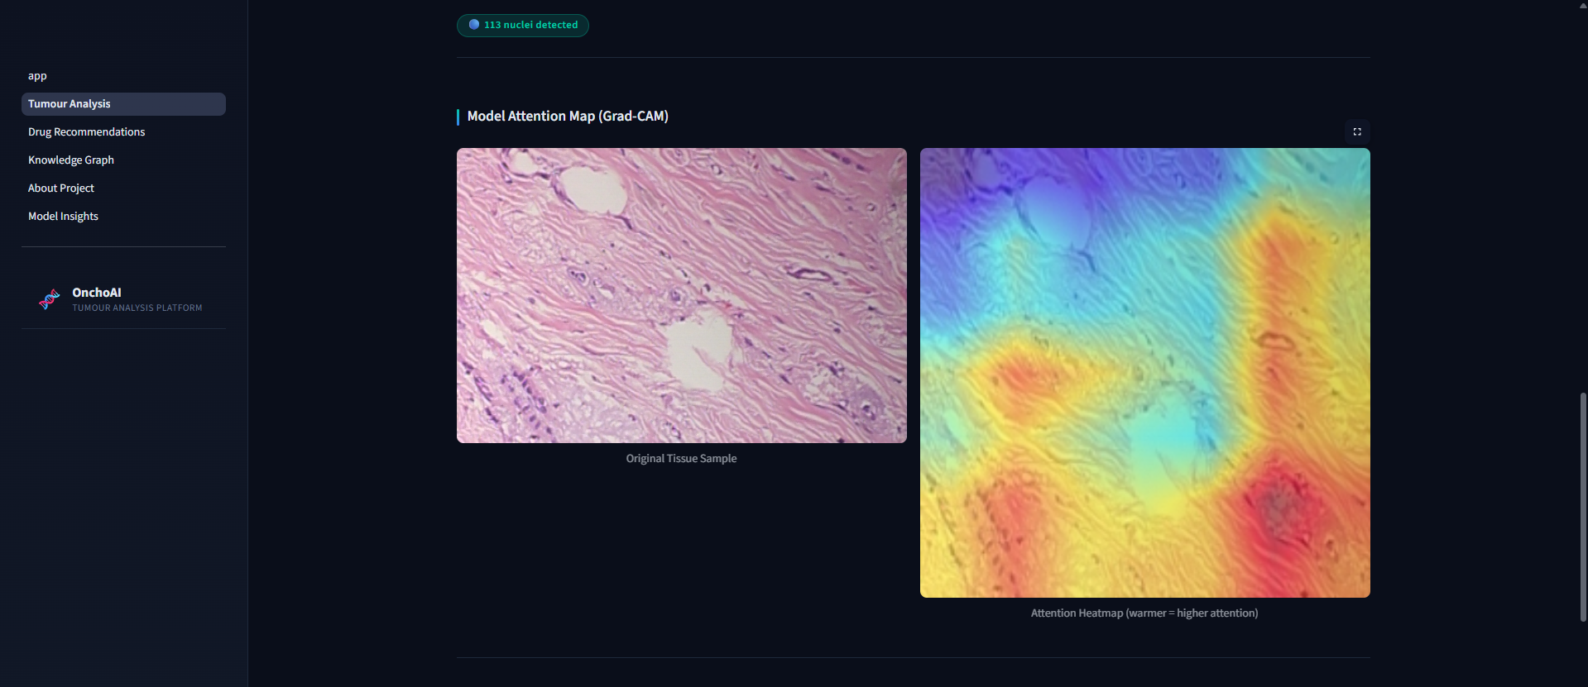
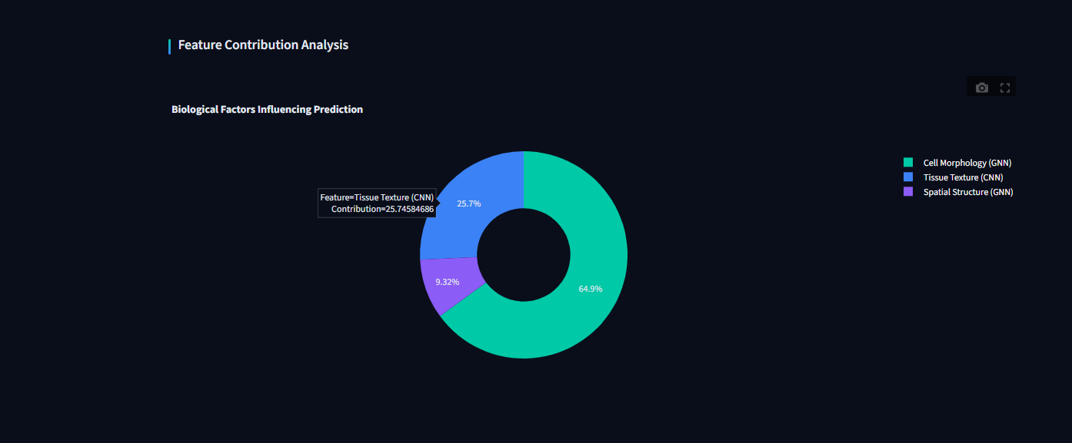
DEMO OUTPUT
MULTI-MODAL AI FOR CANCER CELL BEHAVIOUR AND DRUG DISCOVERY
22

Slide 23
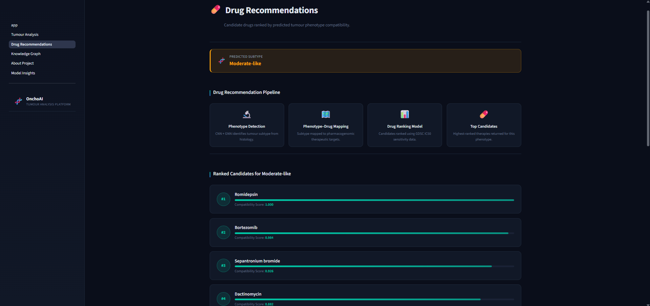
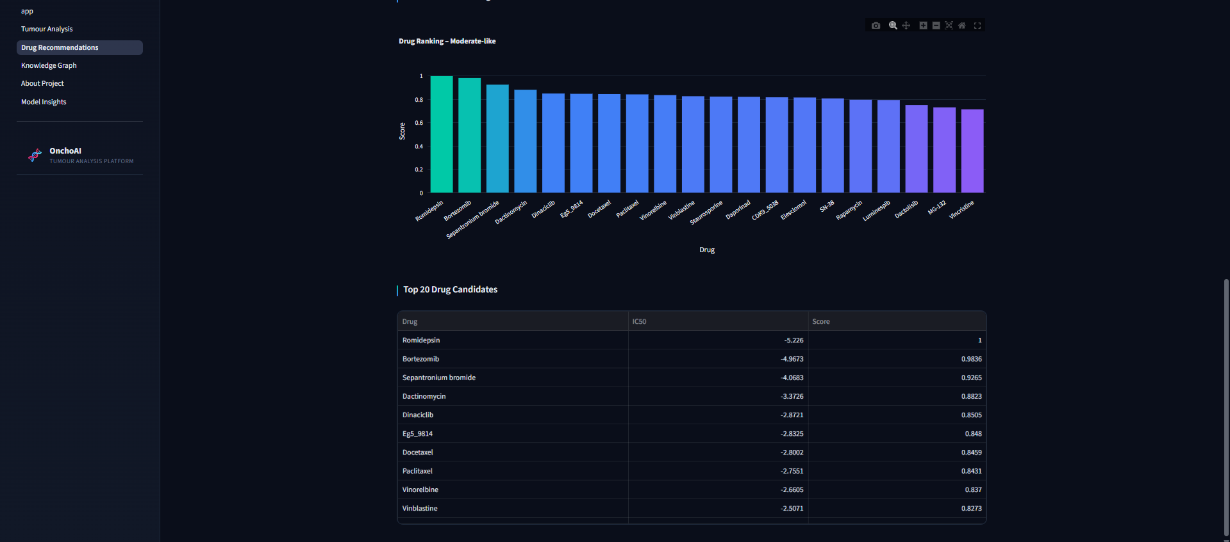
DEMO OUTPUT
MULTI-MODAL AI FOR CANCER CELL BEHAVIOUR AND DRUG DISCOVERY
23

Slide 24
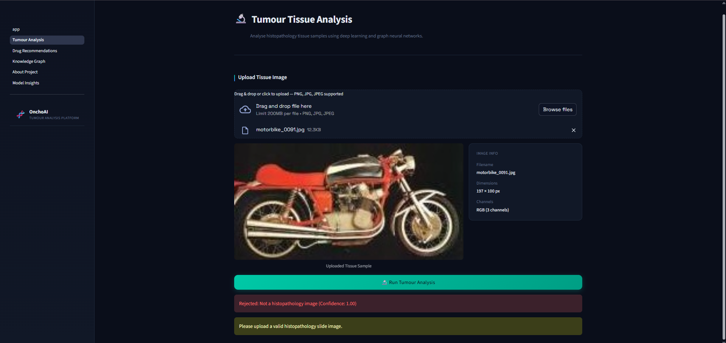
DEMO OUTPUT
MULTI-MODAL AI FOR CANCER CELL BEHAVIOUR AND DRUG DISCOVERY
24

Slide 25
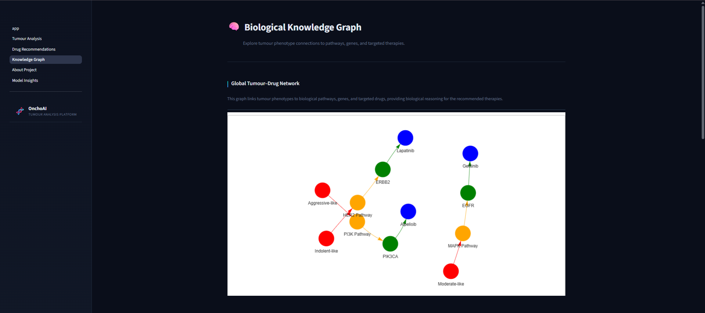
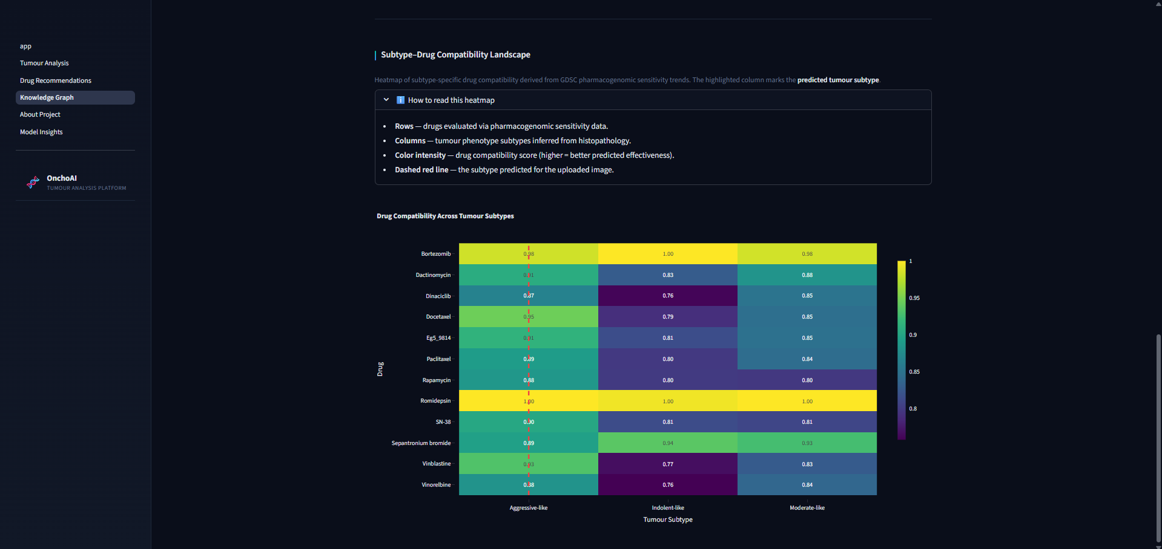
DEMO OUTPUT
MULTI-MODAL AI FOR CANCER CELL BEHAVIOUR AND DRUG DISCOVERY
25

Slide 26
REFERENCES
Jinxin Li, Xinguo Lu, Kaibao Jiang, Daoxu Tang, Bin Ning, Fengxu Sun,
“TARSL: Triple-Attention Cross-Network Representation Learning to Predict Synthetic Lethality for Anti-Cancer Drug Discovery,”
IEEE Journal of Biomedical and Health Informatics, Vol. 29, No. 3, 2025.
Jayachithra G., R. Sridevi,
“MANS-Net: Multiple Attention-Based Nuclei Segmentation Network for Pathological Images,” IEEE Access, 2023.
Muhao Xu, Zhenfeng Zhu, Yawei Zhao, Kunlun He, Qinghua Huang, Yao Zhao,
“RedCDR: Dual Relation Distillation for Cancer Drug Response Prediction,” IEEE/ACM Transactions on Computational Biology and Bioinformatics, Vol. 21, No. 5, 2024
MULTI-MODAL AI FOR CANCER CELL BEHAVIOUR AND DRUG DISCOVERY
26

Slide 27
REFERENCES
A Zhen Zhang et al.,“Cross-Boosted Multi-Target Domain Adaptation for Multi-Modality Histopathology Image Translation and Segmentation,”Computer Vision and Image Understanding, 2024
Chan et al.,“Whole Slide Image Analysis with Heterogeneous Graph Representation Learning,”Proceedings of the IEEE Conference on Computer Vision and Pattern Recognition (CVPR), 2023.
He et al.,“MANS-Net: Multiple Attention-Based Nuclei Segmentation in Multi-Organ Digital Cancer Histopathology Images,”IEEE Access, 2023.
MULTI-MODAL AI FOR CANCER CELL BEHAVIOUR AND DRUG DISCOVERY
27

